Slide 1
Modern Media
through MySQL
Kourosh Alasti, Zhenting Huang, Kevin Kiely

Slide 2
Introduction
Our SQL Project will be exploring our world through the Modern Media Mediums: Music, Video games, and Movies. Using Structured Query Language(SQL), we analyzed our data and created complex queries to identify major companies, artists, and movies throughout the world.
We did this using an ER diagram and a database schema and physical and relational models.
We also used 20 queries in our exploration of entertainment as well.

Slide 3

Why Modern Media
Modern Media is a good way to unwind after a long day at work, especially working for the United Nations to put it in the context of the problem. Plus, many world economies profit off of entertainment especially if its a singer or artist that is super popular such as Taylor Swift, then they will bring in a lot of tourism to countries and cities and thus allowing them to boost their GNP.

Slide 4
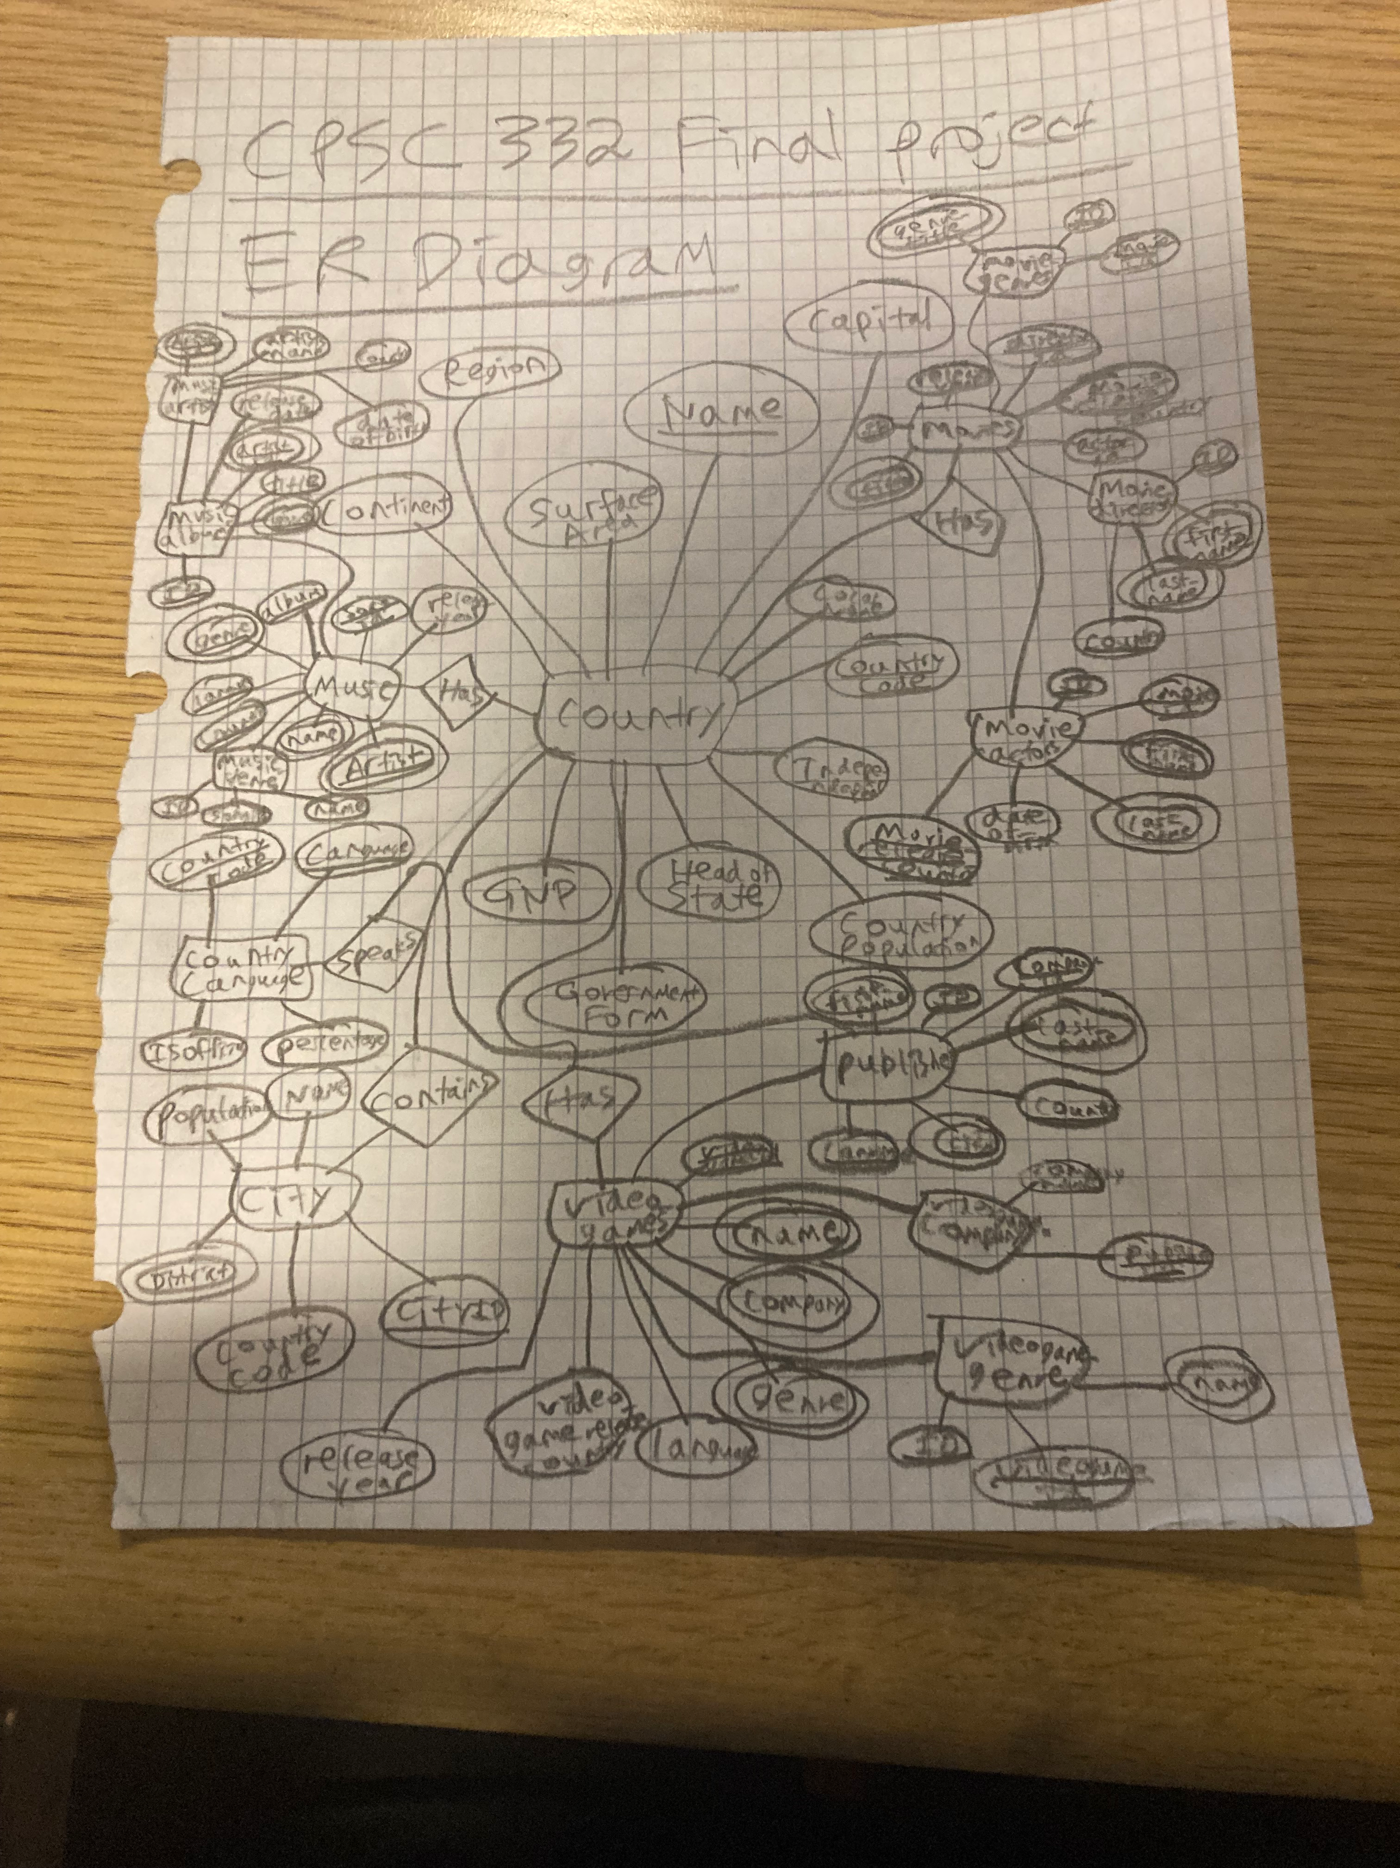
ER Diagram
The following image represents our ER Diagram based on our Physical Model of Modern Media. Country is our main table and at the center of our Diagram as it is connected / related all other Main Tables of our project.
Looking through the Diagram, you will notice that Each Song, Video game, or Movie can be traced back to a country.
These relationships are visible through their one-to-many and many-to-one relationships between the Country Table and each table connected to Country.

Slide 5
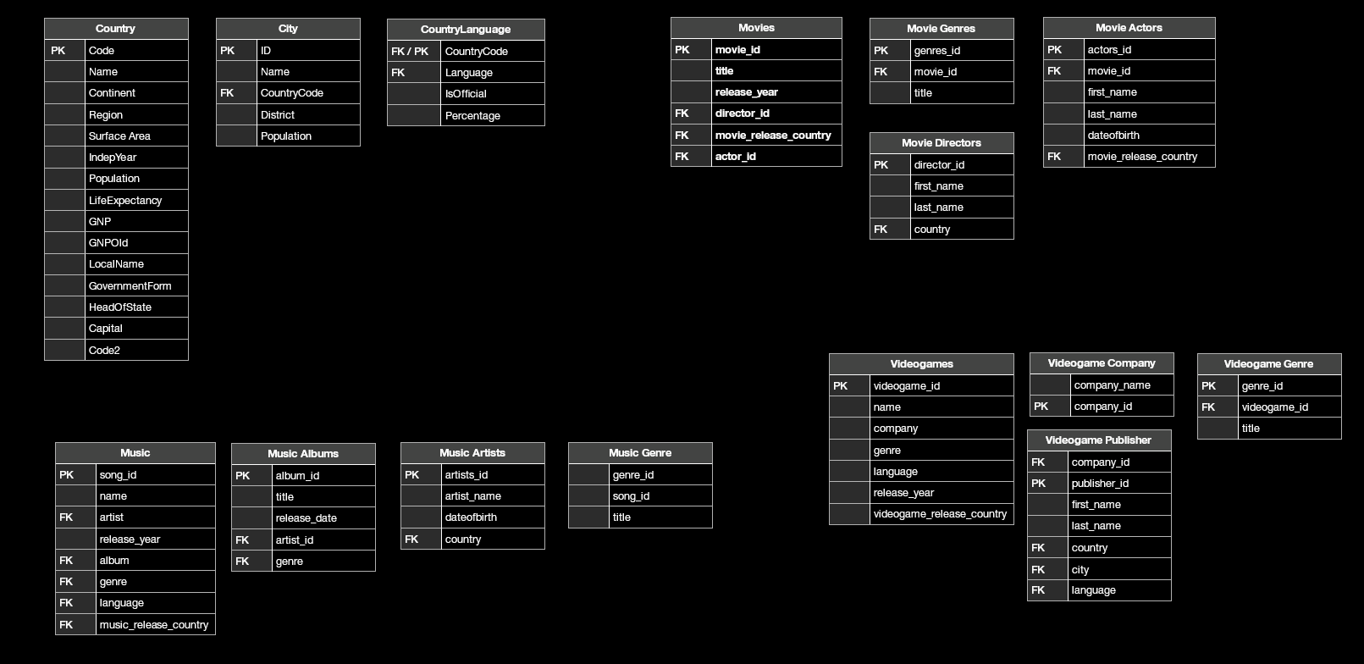
Database Schema
This screenshot depicts our DB Schema along with our Table Layout. We have gone ahead and labeled all tables with their respective primary and foreign keys to show the complex relationships between our DB Tables.
The Tables Country, City, and CountryLanguage where given to us from the world.sql file, while we went ahead and added 3 main tables Movies, Videogames, and Music. Each of these tables have "sub-tables" that you can see in the diagram.
All the Data we used for these tables came from the internet. SpotifyAPI for music, Google for Video Games and IMDB for the Movies.
DB Schema modeled in Apple Numbers

Slide 6
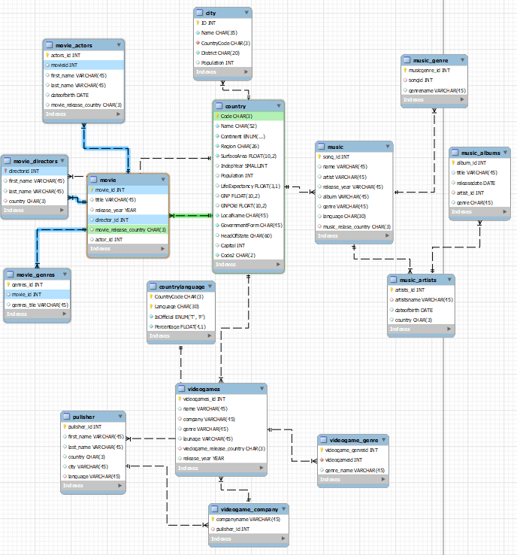
Physical Model
This screenshot represents our Physical Model for Modern Media. There are many tables as a part of our projects and therefor we have minimized the complexity of our Physical Model using our main tables for this mode.
The following tables are presented:
Country
CountryLanguage
City
Movies, with subtables Movie Actors, Movie Directors, Movie Genres
Video Games, with subtables: Publishers, Video Game Genre, Video Game Company
Music, with subtables: Music Genre, Music Albums, Music Artists
Physical Model modeled using MySQL Workbench

Slide 7
DB Tables
Music
Movies
Video Games

Slide 8
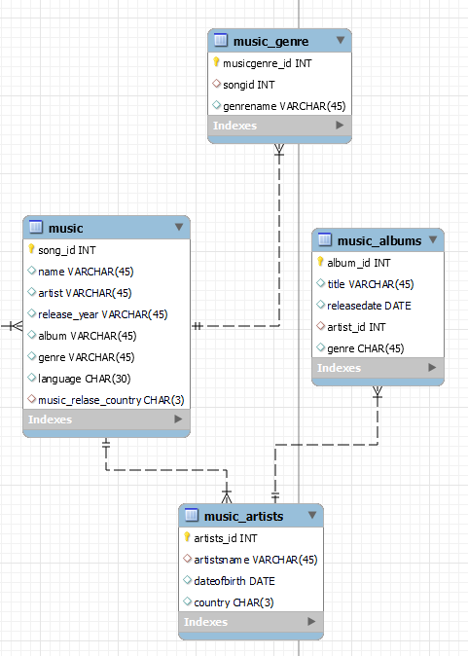
Music Tables
Music Table Attributes:
song_id (INT) [PRIMARY KEY]
name (VARCHAR)
artist (VARCHAR) [FOREIGN KEY]
release_year (VARCHAR)
album (VARCHAR) [FOREIGN KEY]
genre (VARCHAR) [FOREIGN KEY]
language (CHAR) [FOREIGN KEY]
music_release_country (CHAR) [FOREIGN KEY]
Music Genre Attributes:
musicgenre_id (INT) [PRIMARY KEY]
songid (INT) [FOREIGN KEY]
genrename (VARCHAR)
Music Albums Attributes:
album_id (VARCHAR) [PRIMARY KEY]
title(VARCHAR)
releasedate (DATE)
artist_id (INT) [FOREIGN KEY]
genre (CHAR) [FOREIGN KEY]
Music Artists Attributes:
artist_id (INT) [PRIMARY KEY]
artistname (VARCHAR)
dateofbirth (DATE)
country (CHAR) [FOREIGN KEY]
Music Tables Modeled using MySQL Workbench

Slide 9
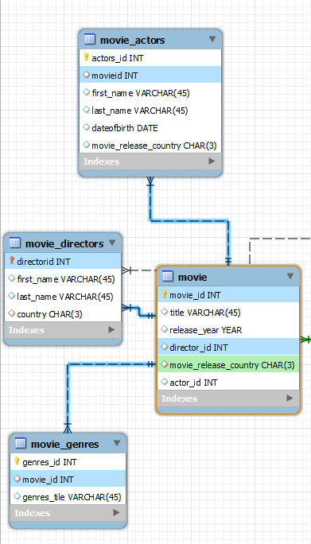
Movie Tables
Movie Table Attributes:
movie_id (INT) [PRIMARY KEY]
title (VARCHAR)
release_year (YEAR)
director_id (INT) [FOREIGN KEY]
movie_release_country (CHAR) [FOREIGN KEY]
actor_id (INT) [FOREIGN KEY]
Movie Genre Attributes:
genre_id (INT) [PRIMARY KEY]
movie_id (INT) [FOREIGN KEY]
genre_title (VARCHAR)
Movie Directors Attributes:
director_id (INT) [PRIMARY KEY]
first_name (VARCHAR)
last_name (VARCHAR)
country (CHAR) [FOREIGN KEY]
Movie Actors Attributes:
actor_id (INT) [PRIMARY KEY]
movie_id (INT) [FOREIGN KEY]
first_name (VARCHAR)
last_name (VARCHAR)
dateofbirth (DATE)
movie_release_country (CHAR) [FOREIGN KEY]
Movie Tables Modeled using MySQL Workbench

Slide 10
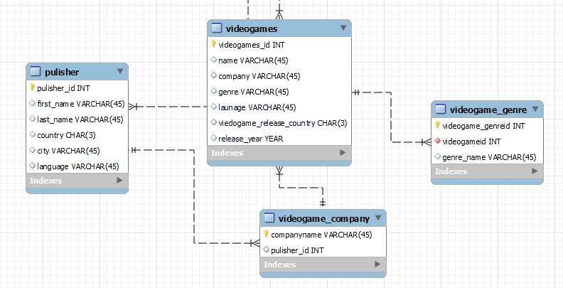
Video Games Tables
Video Games Attributes:
vigeogame_id (INT) [PRIMARY KEY]
name (VARCHAR)
company (VARCHAR) [FOREIGN KEY]
genre (VARCHAR) [FOREIGN KEY]
language (VARCHAR) [FOREIGN KEY]
videogame_release_country (CHAR) [FOREIGN KEY]
release_year (YEAR)
Video Game Genre Attributes:
videogame_genre_id (INT) [PRIMARY KEY]
videogame_id (INT) [FOREIGN KEY]
genre_name (VARCHAR)
Video Game Company Attributes:
comapnyname (VARCHAR) [PRIMARY KEY]
publisher_id (INT) [FOREIGN KEY]
Publisher Attributes:
publisher_id (INT) [PRIMARY KEY]
first_name (VARCHAR)
last_name (VARCHAR)
country (CHAR) [FOREIGN KEY]
city (VARCHAR) [FOREIGN KEY]
langauge (VARCHAR) [FOREIGN KEY]
Video Games Tables modeled using MySQL Workbench

Slide 11
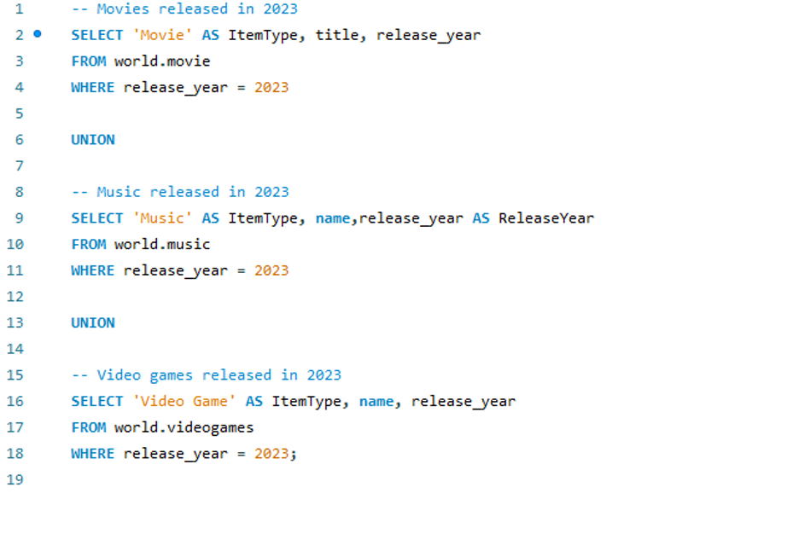
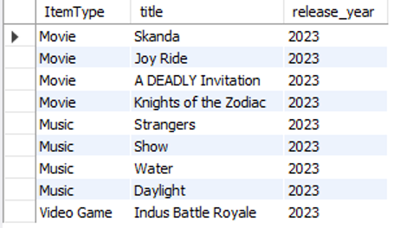
Queries pt.1
This query is about movies and music and video games released in 2023. The purpose of this query is to give the UN chief information about entertainment released in 2023 in case if his or her workers ask for that information.

Slide 12
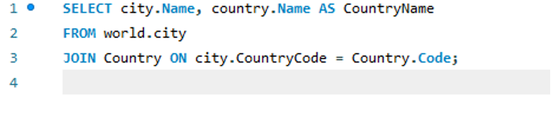
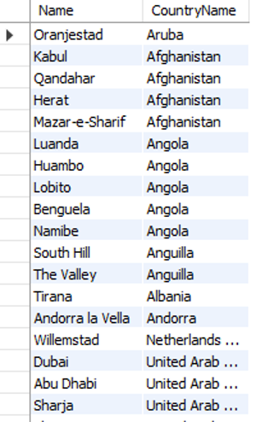
Queries pt.2
This query is about cities and their countries. The purpose of this query is to give the UN chief information regarding cities and their countries. This is important because if a country is experiencing a refugee crisis, it would be important for the UN to have information about that country to better assist them in their response.

Slide 13
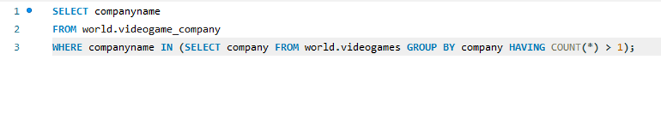
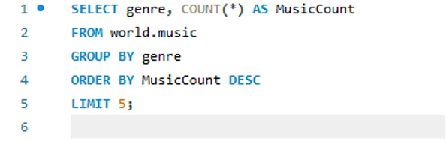
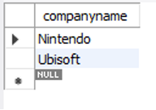
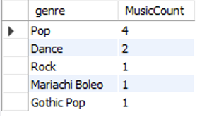
Queries pt.3
Companies with more than one video game out. Most common music genres.

Slide 14
Key Takeaways
Understanding Data and Database Relations. (ex. city to country, music to artist)
DataTypes and Constraints (ex. VARCHAR, INT, Foreign and Primary Keys)
Real-world Applications for Databases (ex. storing music information in SpotifyAPI)
Collaboration between Team members

